Slide 1
MAR 580: Advanced Population Modeling for Management of Living Marine Resources
Lecture 3
Mixed effects models
www.mycourses.umassd.edu
(Acknowledgements: André Punt, Arni Magnusson, Jim Thorson)
15 September 2015

Slide 2
Today’s Outline
Review of linear models
Introduction to mixed effects models
Parameter estimation for mixed effects models
Lab exercise/assignment
Fitting mixed effects models in R and ADMB
Stock-recruitment meta-analysis

Slide 3
Linear modeling review LMs, GLMs, NLMs
LM and GLM are used to describe whether and how a response variable depends on a combination of predictors.
Predictors can be numeric (continuous) or factors (categorical).
Linear
Quite flexible as it is
Generalized
Any error distribution
Nonlinear
Any relationship between Y and X
closed form solution
iterative solution

Slide 4
What are Fixed and Random Effects?
Fixed Effects:
Parameters associated with the entire population or with certain repeatable levels of experimental units.
Random Effects:
Parameters associated with individual experimental units drawn at random from a population.
A mixed effects model is a model that has both fixed effects and random effects.
Classical (frequentist) and Bayesian methods can be used to estimate the parameters of mixed effects models.
Often the same random effect is assigned to observations sharing a common classification factor:
Consider length-at-age data for several (randomly selected) stocks of a species. The random factor is stock and the observations are length-at-age data.
Random effects can the thought of as ways of modeling the covariance structure of the data.

Slide 5
Linear Mixed Effects Models
Vector of fixed effects
Observations for group i
Vector of random effects
The traditional linear modeling framework is a special case of
of this model in which there are no random effects.

Slide 6
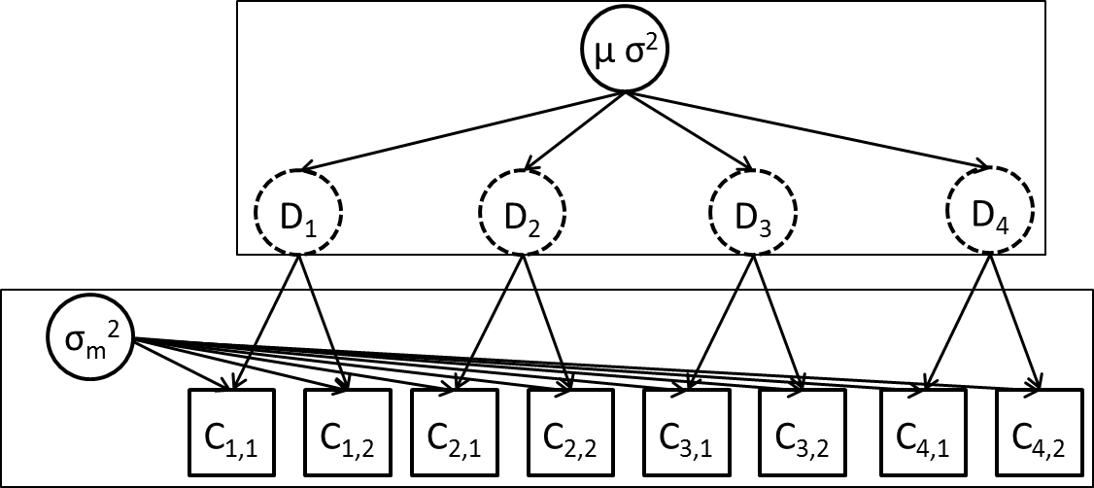
Example 1: Streams [Lecture_03.r] (sensu Pinherio and Bates, Chapter 1)
We are estimating fish density in streams.
We select six streams at random and determine the density at each stream three times.
The questions:
What is the density in a typical stream?
What is the variation in density among streams?
What is the variation in density estimates within a stream?
We would like to separately estimate measurement and between-site variability.

Slide 7
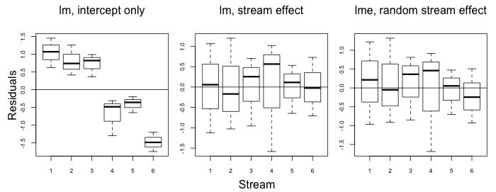
Fitting linear models
Stream
This analysis attributed all the error to within-stream variation. It is clear that there is between-stream variation in density but we have no way to comment on it.

Slide 8
Fitting linear models
The residual pattern has been removed, but we have no overall mean and no way to comment on between-stream variance. We cannot say anything about the population of streams.

Slide 9
Example 1: Streams mixed effects model
We construct a mixed effects model as follows:
β is the mean density across the population,
b_{i} is a random variable representing the deviation from the population mean for stream i
ε_{i,j} is a random variable representing the deviation for observation j from mean density for stream i, i.e.

Slide 10
Fitting linear mixed effects models
These estimates are similar to the linear model with separate “stream effects” (but would not be if this was an unbalanced design).

Slide 11
Mixed Effects Model (Some notes)
Residuals are assumed to be independent, normally distributed random variables with constant variance.
Random effects are assumed to be normally distributed.
This only works if the streams have been selected at random from the population of streams.
Mixed effects models are also called hierarchical models.
This model has 3 parameters (β, σ and σ_{b}).
There are ways to estimate the random effects (we will often be interested in their values).

Slide 12
Estimation of mixed effects models
Maximum Likelihood Estimation (MLE)
is the vector of fixed effects parameters.
are the parameters controlling the distribution for the random effects.
We integrate across the random effects.
Effectively weight the probability of the observations given values for random effects by the probability of those values.
In the linear case, closed form solutions exist. For nonlinear models, evaluate numerically or use approximations.

Slide 13
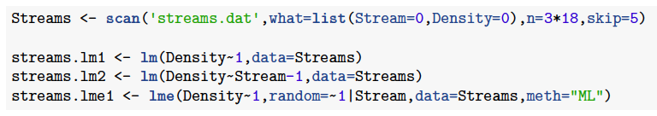
Estimating using R
lme() in package nlme, lmer() in lme4.
nlme() used to fit nonlinear models
The call to lme() first gives the fixed effects (the intercept in this case), and then the random component of the model.

Slide 14
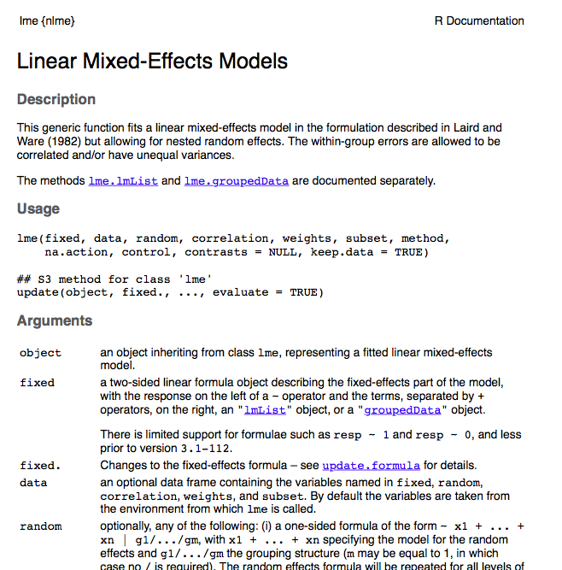
?lme
Fit using ML or restricted maximum likelihood (REML). REML more robust but more gnarly equations.

Slide 15
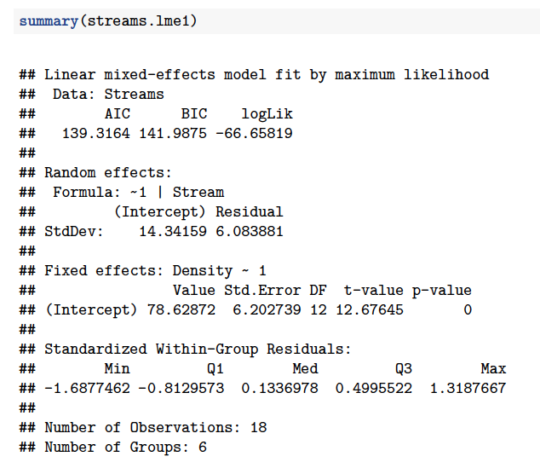
lme() output
among stream variation
within stream variation
fixed effects

Slide 16
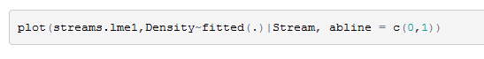
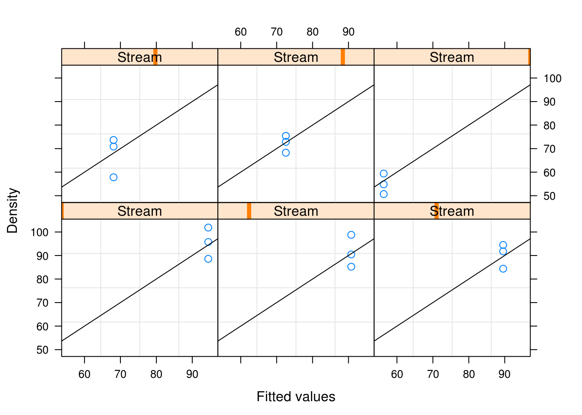
Fit of the model
Always plot your data and results!

Slide 17
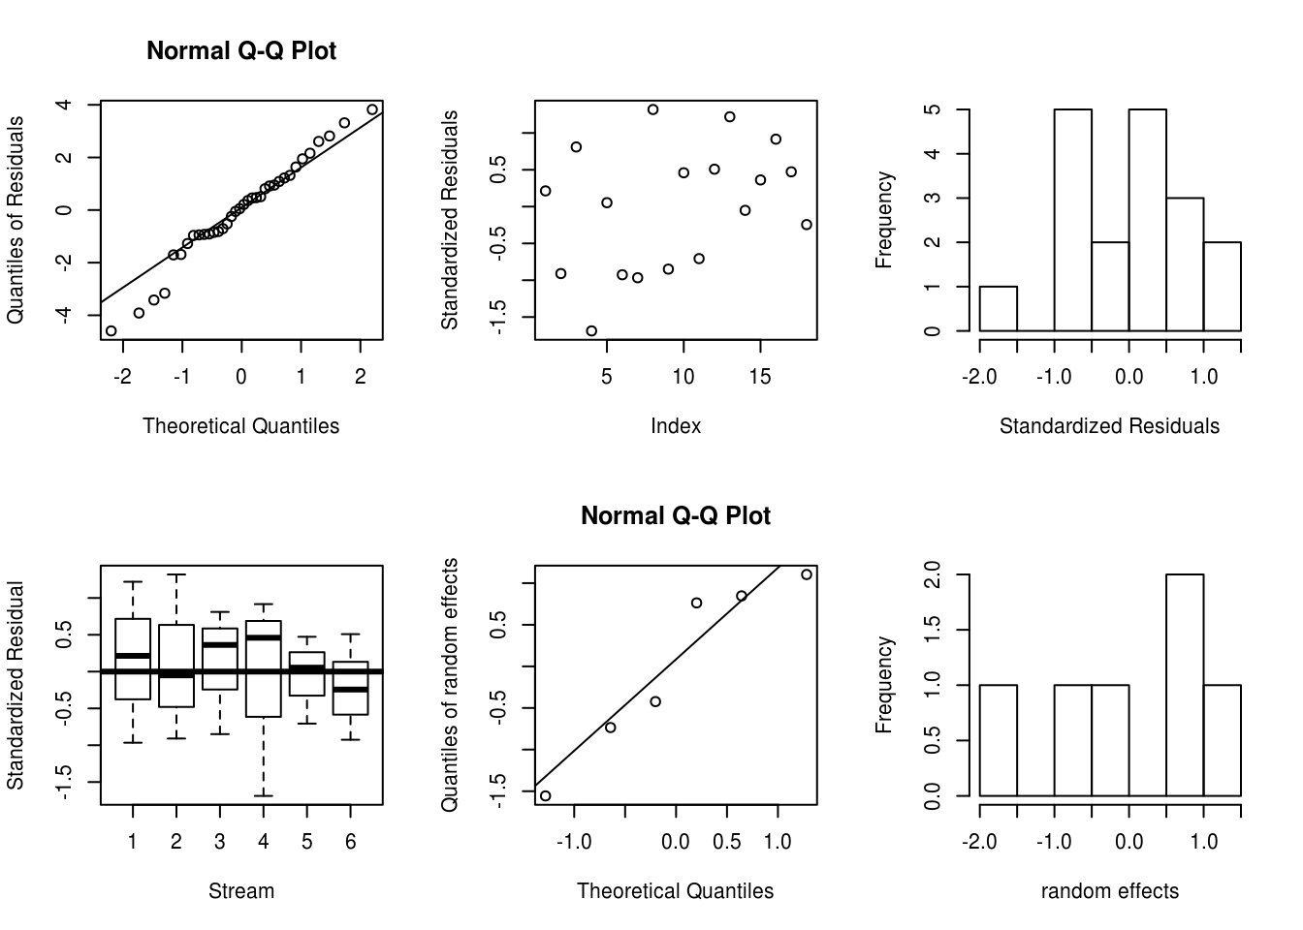
Inspecting residuals, etc.

Slide 18
Model selection with both fixed and random effects (Zuur et al. 2009)
Set the fixed effects based on “as many explanatory variables as possible”.
Select a random effects structure using AIC (using REML).
Fix the random effects structure and compare fixed effects options (using ML estimation). [Likelihood tests do not work with REML]
Compute the final model using REML.

Slide 19
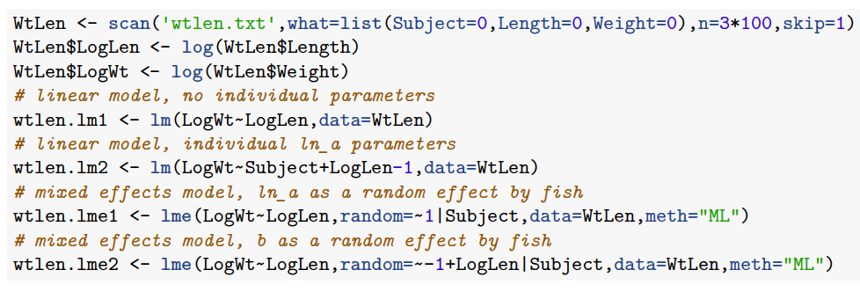
Example 2: Weight-length relationships
Recall the weight-length example
Select 10 individual fish at random and measure their lengths and weights as they grow.
We are interested in whether a or b differ among individuals.

Slide 20
Tricks and Traps
If you use REML estimation, you can only compare models with the same fixed-effects structure.
The standard output does not provide:
the “best estimates” of the random effects - use coef(lmout) or ranef(lmout) to find them.
the confidence intervals for the variance parameters – use intervals(lmout, 0.95)

Slide 21
Random effects in ADMB
DATA_SECTION
init_int ndata;
init_int nstream;
init_ivector streams(1,ndata);
init_vector y(1,ndata);
PARAMETER_SECTION
init_number ln_beta;
init_number ln_sigma;
init_number ln_sigma_b(2);
vector ypred(1,ndata);
random_effects_vector b(1,nstream,2);
objective_function_value obj_fun;
PROCEDURE_SECTION
// distribution for the random effects
obj_fun += 0.5*norm2(b);
// normal likelihood function
ypred = mfexp(ln_beta) + mfexp(ln_sigma_b)*b(streams);
obj_fun += ndata*ln_sigma + norm2(y-ypred)/square(mfexp(ln_sigma));
REPORT_SECTION
report << “b” << endl;
report << mfexp(ln_sigma_b)*b << endl;
random_effects_vector
random_effects_matrix
Phases, this means this parameter will not be estimated until phase 2.
(Use a negative phase to turn off estimation for a parameter).
Specify distribution for random effects Note here I have made these N(0,1) variables.

Slide 22
Extending the linear mixed model
A non-linear relationship between the response variable and the covariates:
A non-normal distribution for the random effects.
A non-normal distribution for the within-group variability.

Slide 23
Non-linear Mixed Effects Models
Modeling age and length data for animals that are measured multiple times.
A meta-analysis for the parameters of the stock-recruitment relationship for many stocks.
A surplus production model with process and observation error**.
An age-structured population dynamics model with recruitment variability (Stock Synthesis)**.
** These can be dealt with more straightforwardly by adopting a Bayesian rather a classical estimation framework.

Slide 24
Fitting non-linear mixed effects models
R can be used to fit non-linear mixed effects models (function nlme).
To fit non-linear mixed effects models using ADMB or EXCEL you need to evaluate the integral numerically, or apply a method such as the Laplace approximation.
is the value of ε obtained by maximizing given fixed values of θ and τ, and is the determinant of the matrix of second derivatives.
This approximation is exact when the distribution of random effects (given their hyper-prior and the available data) is exactly proportional to a multivariate normal distribution. (It is a convenient approximation in other cases)
Skaug & Fournier (2006), Thorson & Minto (2015)

Slide 25
Example: Meta-analysis for the parameters of the stock-recruitment relationship
Dorn (2002)
Management plans for federally-managed species are required to include an estimate of FMSY (the fishing mortality that maximizes the long-term catch) and ensure that it is not exceeded.
FMSY depends on the slope of the stock-recruitment relationship at the origin, but it is difficult to estimate this parameter (and the related “steepness” parameter).
Question: Can we use stock recruit data from 11 known rockfish stocks to develop an estimate of steepness for an “unknown” rockfish stock?
Steepness is the fraction of virgin recruitment expected at 20% of the unfished spawning biomass level (Mace & Doonan 1988) and might be expected to be interchangeable among species/stocks.

Slide 26
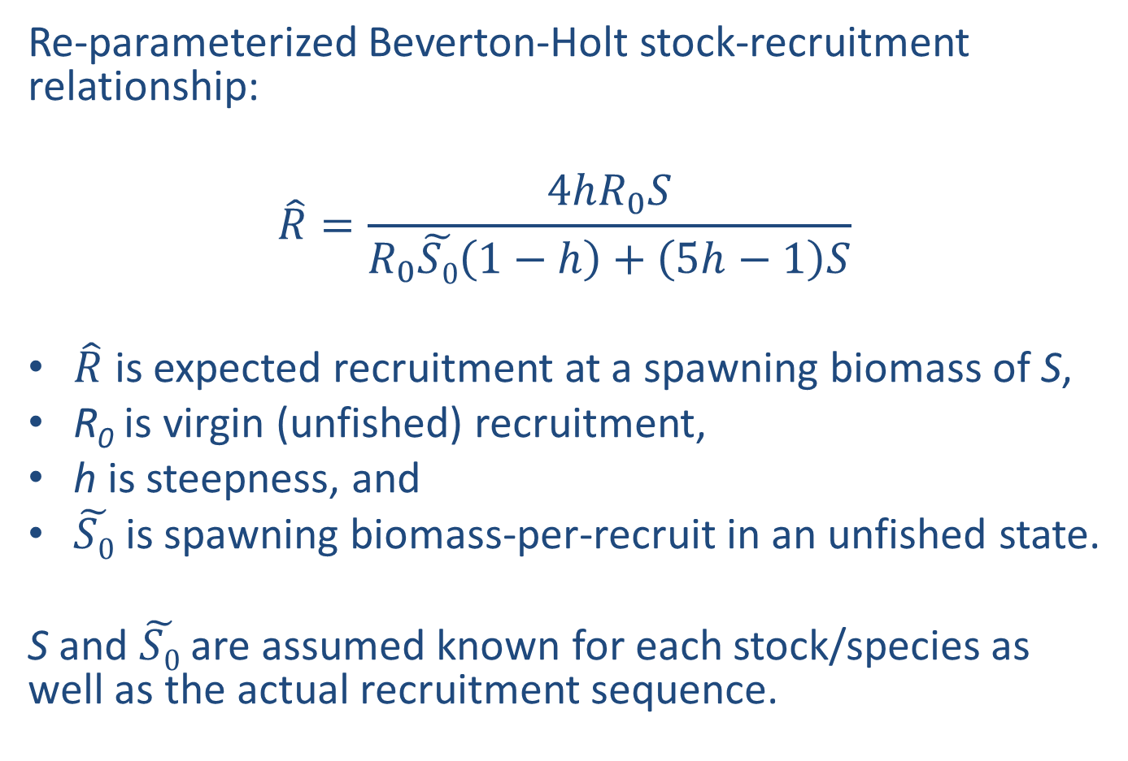
Methods
Re-parameterized Beverton-Holt stock-recruitment relationship:
$$\hat{R}=\frac{4hR_{0}S}{R_{0}\tilde{S0}\left(1−h\right)+\left(5h−1\right)S}$$
$\hat{R}$ is expected recruitment at a spawning biomass of S,
R₀ is virgin (unfished) recruitment,
h is steepness, and
$\tilde{S0}$ is spawning biomass-per-recruit in an unfished state.
S and $\tilde{S0}$ are assumed known for each stock/species as well as the actual recruitment sequence.

Slide 27
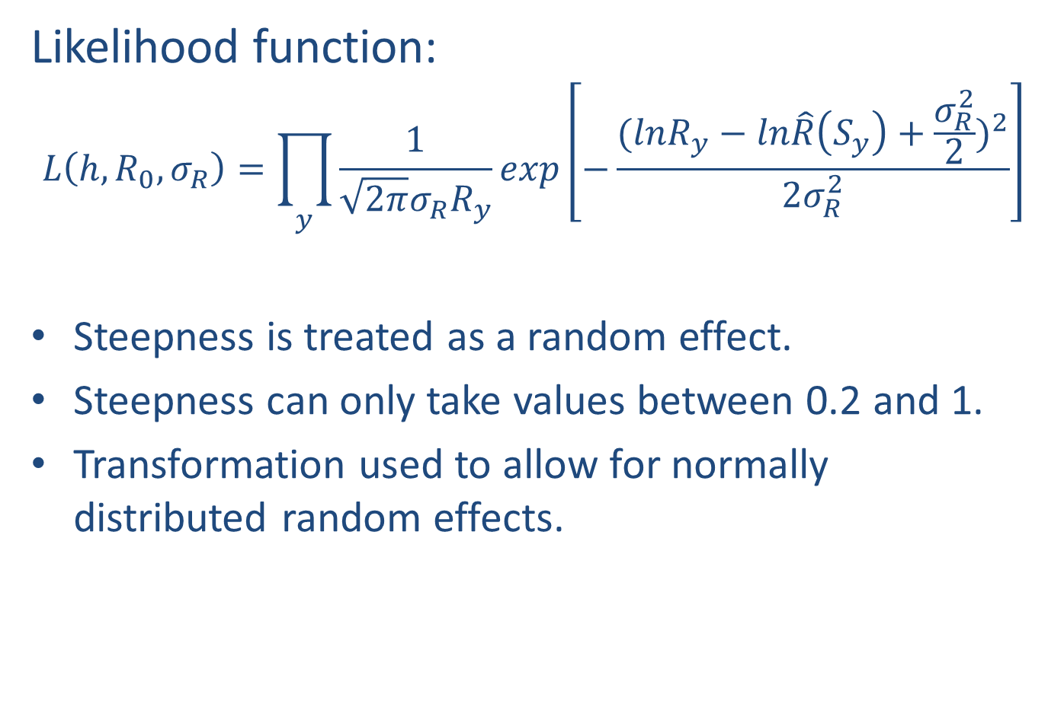
Methods
Likelihood function:
$$L\left(h,R_{0}, σ_{R}\right)=\prod_{y}{\frac{1}{\sqrt{2π}σ_{R}R_{y}}exp\left[−\frac{{(lnR_{y}−ln\hat{R}\left(S_{y}\right)+\frac{σ_{R}^{2}}{2})}^{2}}{2σ_{R}^{2}}\right]}$$
Steepness is treated as a random effect.
Steepness can only take values between 0.2 and 1.
Transformation used to allow for normally distributed random effects.

Slide 28
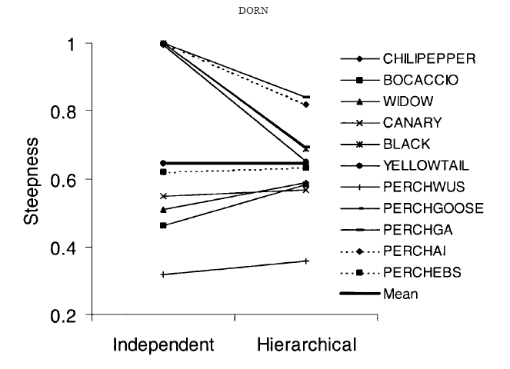
Results
Posterior distribution for β
Evidence for shrinkage
Outcomes:
The median of the posterior for steepness (~0.65) has been included in several assessments of west-coast rockfish species.
The implication that productivity for rockfish is lower than for many other fish species was one reason that the target harvest rate for west coast groundfish was reduced in 2002.

Slide 29
Recommended Reading
Bolker et al. (2008). Generalized linear mixed models: a practical guide for ecology and evolution. TREE: 24: 127-35.
Pinheiro, J.C. & Bates, D.M. (2000). Mixed-Effects Models in S and S-PLUS. New York: Springer-Verlag.
Skaug, H. J., & Fournier, D. A. (2006). Automatic approximation of the marginal likelihood in non-gaussian hierarchical models. Computational Statistics & Data Analysis, 51(2), 699-709.
Thorson, J. T., & Minto, C. (2014). Mixed effects: a unifying framework for statistical modelling in fisheries biology. ICES Journal of Marine Science: Journal du Conseil, fsu213.
Venables, W. N., & Dichmont, C. M. (2004). GLMs, GAMs and GLMMs: an overview of theory for applications in fisheries research. Fisheries Research, 70(2), 319-337.
Zuur et al. (2009). Mixed-effects Models and Extensions in Ecology with R. New York: Springer-Verlag.

Slide 30
What’s Next?
Guest Lecture (Tim Miller, NOAA Fisheries)
State-space age-structured model with environmental covariates
Reading: TBC

